Slide 1

iCliQ
Company of Noobs

Slide 2
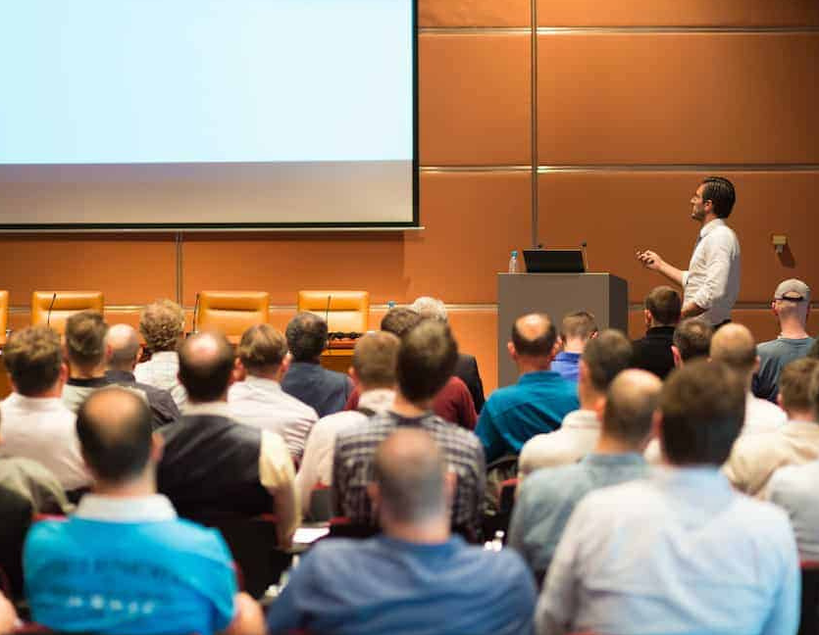
Problem Description
Managing time is hard for both professional & amateur speakers
Aspiring public speakers get nervous while delivering the speech
Non intuitive design of the clickers in the market

Slide 3

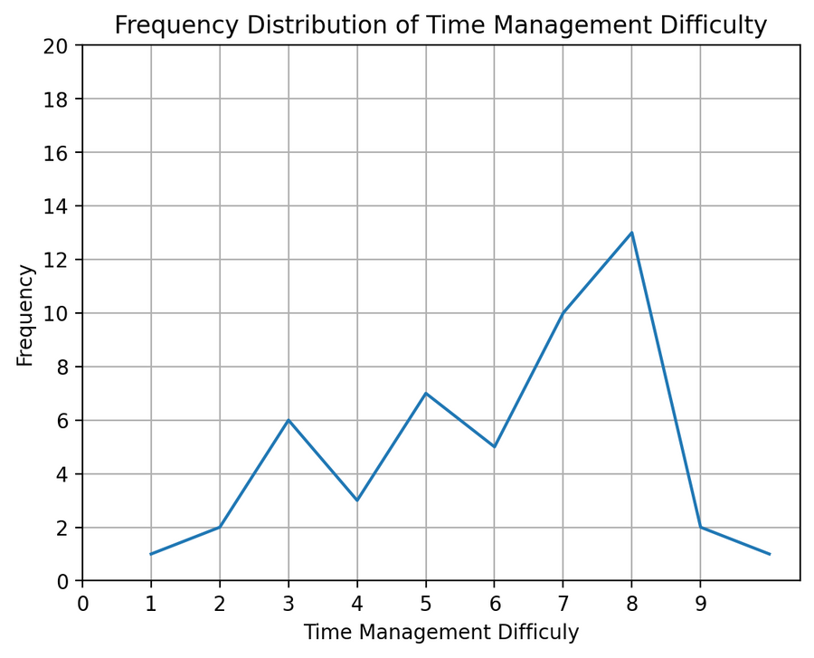
Product Idea
Validation
According to our survey, most public
speakers struggle to manage their time
during the speeches.

Slide 4
Solution
Main Features
Secondary Features
Novel method to manage time using Vibration Patterns
Reimaging Time Card concept with light indicators
Ergonomic Wearable Design
Intuitive User Interface
Vibrotactile Haptic Sensing for Stress Reduction
Keeping Visual Notes (Optional)
Accessibility features for Dyslexic users (Optional)

Slide 5
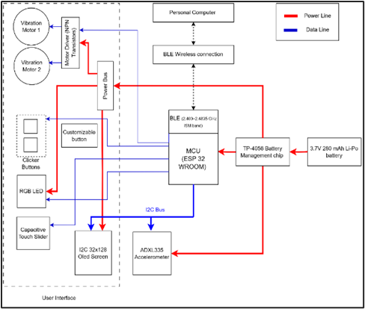
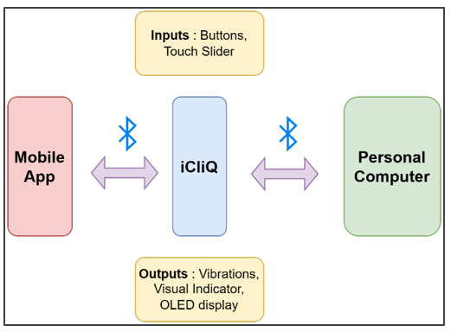

Product Architecture

Slide 6
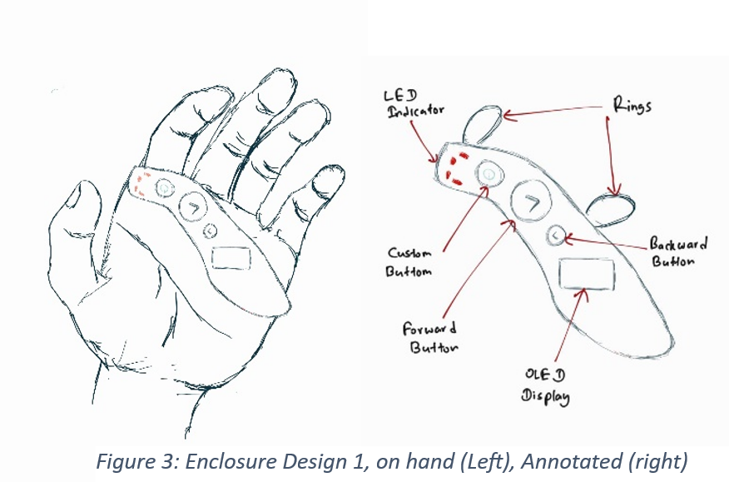
Designs
Design 1

Slide 7
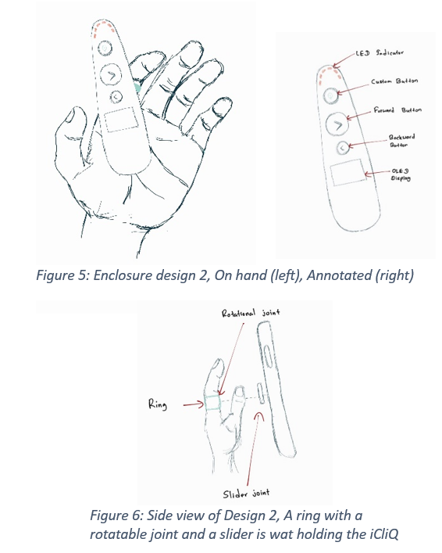
Design 2

Slide 8

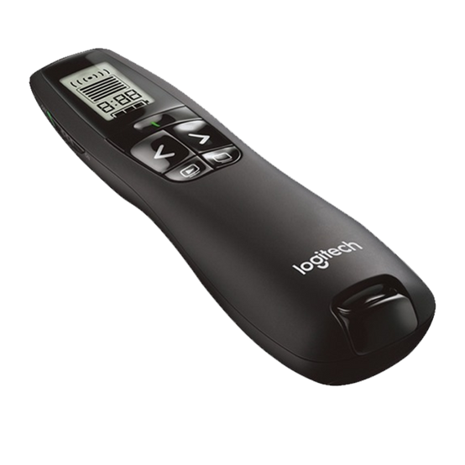
Competitive Analysis
Leading - companies
Logitech
Baseus
Micropack
Logitech's R800 Remote priced at 80 USD
ordinary clicker price range = $20 - $100

Slide 9
Marketing Methods
1) Free subscription for a tutorial course for every purchase
2) Crowdfunding Campaigns
3) Attend Professional Conferences (Toastmasters/Lecturers)
4) Influencer Marketing
5) Paid Advertising
6) Trade Shows and Conferences
7) Customer Reviews and Testimonials

Slide 10
Sales Strategy
1) Direct Sales
2) Partnership programs
3) Through distributors

Slide 11
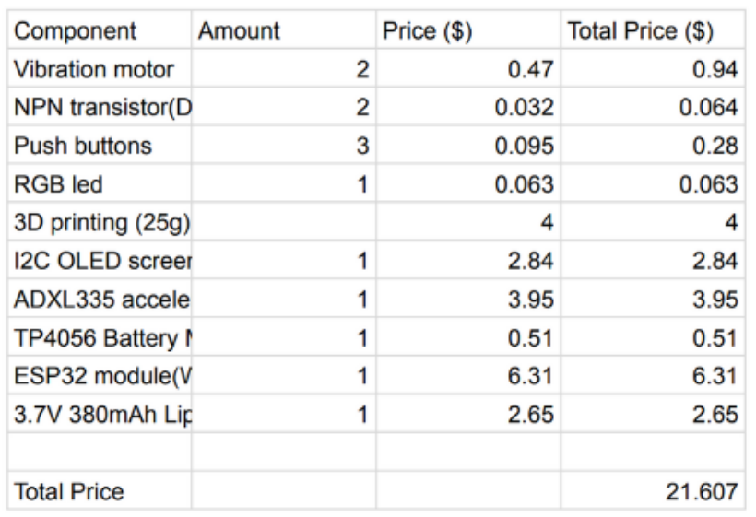
Product Budget(Prototype BOQ)

Slide 12
Product Pricing
(considering a batch of 100 units)
EXPENDITURE
COST(USD)
Components
PCB Manufacturing & Assembly
Shipping
Inventory Costs
Enclosure manufacturing
Packaging
Total cost
21.607 x 0.6 x 100 = 1296.00
90.81
116.34
0.00
70.00
60.00
1633.15
Estimated product price = $20
*Including 15% profit margin

Slide 13

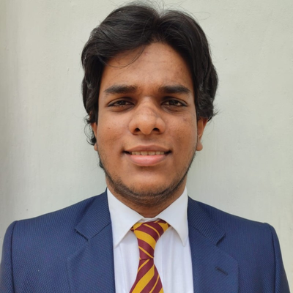
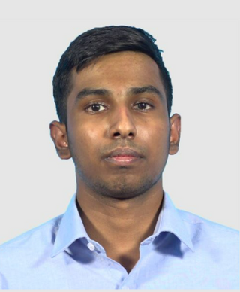

Our Team
Sasika Amarasinghe
Odil Janandith
Sayuru
Shenal
Navindu De
Silva

Slide 14
Thank You
Company of Noobs

